Slide 1

Azure for Dev & Test
<speaker>

Slide 2

Personas
Service Admin
Will be the HSP service administrator that manage the Azure environment on behalf of the service provider
Tenant
Will be the customer who consumes the service in Azure through the CSP subscription
Notes:
During this course, we will mainly deal with the following personas to demonstrate the service provider scenarios and also how tenants are interacting with their services.
The Service Admin represents the IT-pro/DevOp working for the Cloud Service Provider, and is the person who does the design, architecture and instantiates the solutions in Azure.
The Tenant is the customer who subscribes to resources through the CSP subscription.
During demos, look for the persona icon in the upper right, to see whether the actions are performed by the service admin or the tenant

Slide 3

Insider Tip: Topic
When you see these slides, you should pay attention as this is where we will share our best practices from the field
These topics are also great discussions points

Slide 4
What to Expect?
We will be covering the overview of Azure Automation, such as automation accounts, runbooks, DSC configurations, and etc., as well as architecture and challenges.
This will cover each of the core concepts, functional areas and scenarios
Trough examples you will to get a solid understanding of Azure Automation and ensure you are ready to proceed with realizing your scenarios
Notes:
Describe the main points that will be touched during this course. Give information what to expect from the labs that will be executed.

Slide 5
Azure for Dev & Test
These modules gives you an introduction to Azure Automation
This is a highly interactive workshop that:
Provides guidance and reference on the key topics
Talk about the scenarios and technical decisions that occur after
Provide a walkthrough of the main capabilities of Automation – Process Automation and Desired State Configuration (DSC)
Understand the possibilities, flexibility and power, as well as Microsoft’s approach to modern management
Notes:
Describe how CSP members will benefit from this course by executing the labs and taking advantage of insider tips.

Slide 6

Agenda – Dev & Test
Azure Automation
Desired State Configuration
DevOps
Notes:
The agenda for this technical foundation session is focusing on authoring, DSC and DevOps.
But first thing first, a coverage of Azure Automation to get familiar with it and its capabilities.
Azure Automation
We will cover basic Azure Automation terms and architecture for Process Automation feature.
DSC
We will cover basic Azure Automation terms and architecture for DSC feature.
DevOps
We will cover more advanced features of Azure Automation that are related to DevOps and you can take advantage to enhance your DevOps.

Slide 7
Automation
Orchestrate complex and repetitive operations.
Create, monitor, manage, and deploy resources
Reduce errors and boosting efficiency
Notes:
Talk about what Azure Automation represents in general.
Azure Automation is a service that will help you in automating manual, long-running, error-prone and frequently repeated tasks that you need to perform in any cloud or on-premises environment. Currently Azure Automation has two major features: Process Automation and Desired State Configuration (DSC), the latter which is in public preview Strangely, premise (no “s”) and premises (with an “s”) have very different meanings in English.
When we talk about Azure Automation and more specifically to Process Automation we should mention that the service has on-premises equivalent products which are System Center Orchestrator (SCOrch) and System Center Service Management Automation (SMA). Some of the advantages of Azure Automation over those on-premises products are:
Faster release cycles – As a cloud service Azure Automation is being updates with new features and bug fixes every month.
Different types of runbooks – Azure Automation supports three types of runbooks: Graphical, PowerShell Workflow and PowerShell script.
Zero infrastructure – Creating and executing runbooks in Azure Automation does not require deploying infrastructure.
These main advantages over the on-premises products make Azure Automation much more flexible and easier service with richer feature set.
Some “PowerShell Workflow” and “PowerShell workflow” mixed throughout the chapter. We should check MSDN / TechNet documentation and standardize throughout the chapter.
Additional info
https://azure.microsoft.com/en-us/documentation/articles/automation-intro/

Slide 8
Reduce errors and boost efficiency
Reduction of time-consuming, error-prone cloud management tasks
Quick start of automation tasks using Runbook and PowerShell Gallery
Better visibility into automation activities
Creation, monitoring, management, and deployment of resources in cloud and hybrid environments
Ready-to-use runbooks, PowerShell modules and DSC Resources
Runbook monitoring with easy-to-read dashboard charts and log records
Notes:
Creation, monitoring, management, and deployment of resources in hybrid environments
Securely manage and monitor tasks using a runbook across on-premises and cloud environments
Manage on-prem resources in a secure manner with Hybrid Worker
Automate repetitive tasks with Azure Automation to start runbooks daily, hourly, or at a single point in the future
Ready-to-use automation sample, utility, and scenario runbooks
Import sample runbooks from Runbook Gallery or create your own
Leverage the work of the community to build runbooks quickly
Import PowerShell Modules from PowerShell Gallery and use them in automating your management
Import DSC Resources from PowerShell Gallery and use them to build and maintain your infrastructure as code
Runbook monitoring with easy-to-read dashboard charts and log records
Use the chart, jobs table, and quick-glance section of the automation dashboard
Monitor the state of your runbooks and troubleshoot your runbook jobs

Slide 9
A reliable, scalable platform service for orchestrating long-running processes
Integration with Azure and external services using APIs and Webhooks
Faster, more consistent delivery of services
Automation activity reports
Two way integration with the services you depend on
Reliable automation through efficient handling of processes
Insight into and tracking of automation activities with detailed reporting
Notes:
Integration with the services you depend on
Automation runbooks work with Azure Websites, Virtual Machines, Storage, SQL Server, and other popular Azure services
Easily integrate virtually any service offering public Internet APIs
Use webhooks for runbooks to integrate with any modern web service
Reliable automation through efficient handling of processes
Create checkpoints to resume your workflow after unexpected errors, crashes, and network issues
Protect your long-running and expensive tasks from unexpected interruption
Automation activity reports
Get reports based on runbook and job information
Check up on your automation daily, schedule reports daily, and link runbooks to reports

Slide 10
Automation Account & Dashboards
Create Automation Accounts
Organize your automation by group or individual contributor
Accounts can live in different regions
Create up to 30 accounts
Use Automation Dashboard
Operational dashboard for analysis and troubleshooting
Quickly access “problem” jobs to get up and running quickly
Notes:
Talk about the overall structure of Azure Automation – Automation accounts and Dashboards (UI).
Automation Account
When you start Azure Automation for the first time, you must create at least one Automation account. Automation accounts allow you to isolate your Automation resources (runbooks, assets, configurations) from the Automation resources contained in other Automation accounts. You can use Automation accounts to separate Automation resources into separate logical environments. For example, you might use one account for development and another for production.
The Automation resources for each Automation account are associated with a single Azure region, but Automation accounts can manage Azure services in any region. The main reason to create Automation accounts in different regions would be if you have policies that require data and resources to be isolated to a specific region.
Dashboards
Ibiza based portal. Fast, fluid and responsive HTML 5 interface. Beautiful graphics. Modern browsers support.
Additional info:
https://azure.microsoft.com/en-us/documentation/articles/automation-configuring/

Slide 11
Insider Tips: Automation Accounts
User Azure Resource Manager Templates to deploy Automation accounts in bulk
Create multiple automation accounts if needed to give access to different runbooks to separate groups
Create separate automation account for Automation DSC feature
Notes:
Using ARM for Azure Automation deployment allows fast and error-less deployment of the same account to multiple subscriptions.
Creating separate account for Automation DSC feature allows more granular RBAC – different teams can operate Process Automation and DSC.

Slide 12
Service Admin Demo: Deploy Automation Account with all resources via ARM Template. Delegate access to Automation Account Tenant Demo: Access Automation account resources via Azure Portal
Service Admin
Tenant
Notes:
During the demos the instructor will walk trough creation of Automation Account with ARM template. A role that can only executed runbooks will be assigned to Tenant. Tenant will explore the Automation Account trough that role.

Slide 13
Automation Main Features
Process Automation
Manual tasks
Long-running tasks
Error-prone tasks
Frequently repeated tasks
Desired State Configuration (DSC)
Deployment of resources
Control configuration drifts
Infrastructure as a code
DevOps
Notes:
Distinguish the main features in Azure Automation by pointing the main scenarios/strengths they have.
Additional info:
https://azure.microsoft.com/en-us/documentation/articles/automation-intro/

Slide 14
Process Automation

Slide 15
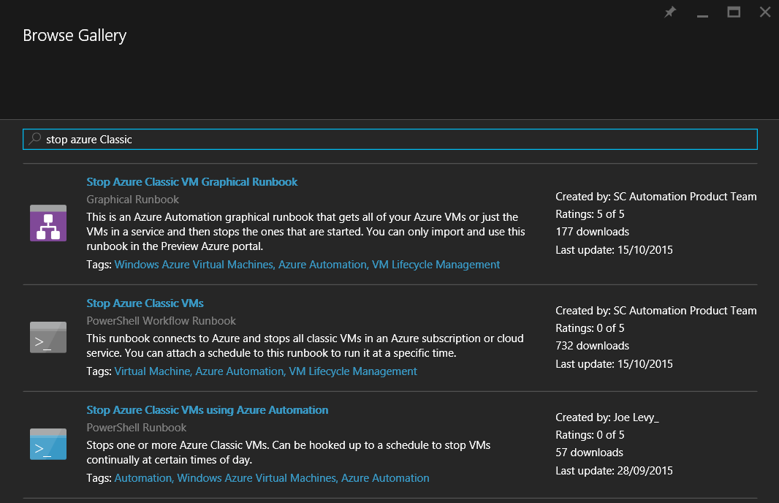
Process Automation - Runbooks
Graphical
PowerShell
PowerShell Workflow
Notes:
Runbooks is a one or more activities tied together that automate a process or operation when executed. A runbook can be a simple process as starting a service or a complicated one such as orchestrating installation of operating system updates of a distributed application that consists of multiple tiers and more than one server in any tier. A runbook can execute tasks at any resource whether it is located in a public cloud, on-premises or in a hybrid cloud or whether it is Windows or Linux-based operating system.
Azure Automation uses PowerShell as a platform and for runbooks more specifically uses Windows PowerShell or Windows PowerShell Workflow. PowerShell is quite popular platform that has many modules that allows you to execute actions against many application and services. These same modules can be loaded in Azure Automation and used in runbooks. PowerShell can execute actions against applications or services without modules by just using their API. This functionality also surfaces in Azure Automation runbooks through the PowerShell platform.
In Azure Automation there are three types of runbooks that can be created – Graphical, PowerShell Workflow and PowerShell.
Graphical
Graphical runbooks are based on Windows PowerShell Workflow. They are authored in a graphical editor available in the Azure Preview Portal. The experience is similar to the Runbook Designer Console in System Center Orchestrator. The sole purpose of this type of runbooks is to provide authoring capabilities for those who are not PowerShell savvy and those who are used to authoring runbooks in System Center Orchestrator. This type of runbooks cannot be authored outside of the Azure Preview Portal. It is possible to export them and import them in the same Automation or account or another one. When graphical runbook is authored on the backed is generated PowerShell Workflow code but that cannot be viewed or edited. The biggest advantage of a graphical runbook is that it visualizes the created process and that visualization can be understood by non-technical workers. As underneath graphical runbooks use PowerShell Workflow code they also inherit some of the its advantages like the ability to create checkpoints and resume the runbook from the last checkpoint upon failure, as well as the ability to do parallel processing by executing several tasks at the same time.
PowerShell Workflow
PowerShell Workflow Runbooks are based on Windows PowerShell Workflow as the name implies. As such they are written in simple text. They can be authored in the Azure Preview Portal via the text editor or offline in any text editor such as Windows PowerShell Integrated Scripting Environment (ISE). When Workflow runbooks are authored offline they can be saved in files with .ps1 extension and imported in Azure Automation account. Workflow runbook’s advantages are parallel processing of activates, ability to create checkpoints and resume from last checkpoint upon failure and ability to execute complex logic. They also have some areas of cautious like time for Workflow Runbook compilation, familiarity with PowerShell Workflow code and deserialization of objects.
PowerShell
The last type of runbooks is PowerShell Runbooks. They are based on PowerShell. You write them like any other PowerShell script. They can be authored in the text editor in Azure Preview Portal or offline in a tool such as PowerShell ISE. With them you can execute complex logic and they start fast as they are not being compiled before execution. As they are based on PowerShell and not PowerShell workflow they lose abilities like parallel processing and creation of checkpoints and resuming from the last checkpoint upon failure.
Additional information:
https://azure.microsoft.com/en-us/documentation/articles/automation-runbook-types/

Slide 16
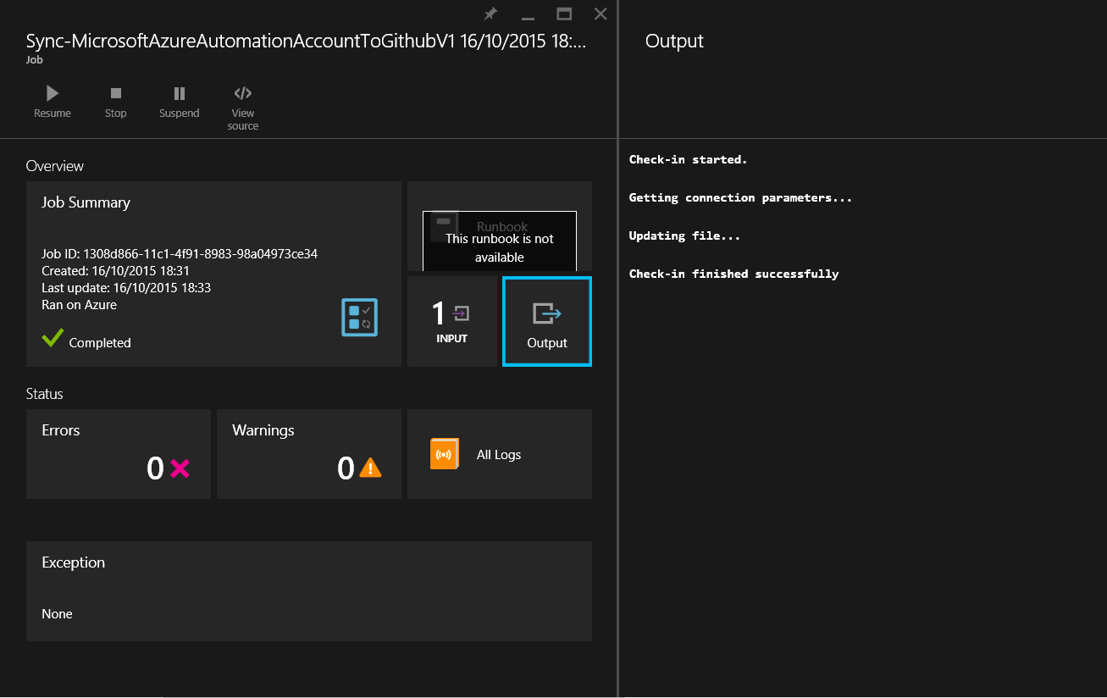
Process Automation - Jobs
Input
Output
Job Summary
Status
Exceptions
Notes:
When runbook is started, a job is created. The job represents a single instance of exaction of a runbook. Once the job is created it is picked up and ran by Azure Automation Worker. Azure Automation has a pools of workers that are shared between multiple Automation accounts. Though jobs from multiple Automation accounts can run on the same Worker they are isolated from each other. With Hybrid Worker which we will cover later in this chapter there is the possibility to run jobs on-premises on your own servers. Jobs can be found in the Jobs blade as shown but also in a blade inside every Runbook. Additional information for every job is available like input, output, summary, status and exceptions.
Additional information:
https://azure.microsoft.com/en-us/documentation/articles/automation-runbook-execution/

Slide 17
Insider Tips: Input, Output and Error-Handling
Define attributes for Input parameters like Name, Type, Mandatory and Default Value
Write description of Input parameters
Output useful information for the runbooks status
Use Try Catch statements to handle errors
Set $ErrorActionPreference variable to control when cmdlets should fail
Notes:
It is best practice to describe as much as possible your input values
Writing description for the input parameters in the beginning of the runbook provides good documentation
Outputting information helps on providing information to those who execute the runbook what has been completed.
Using try catch for different parts of the code helps troubleshooting in case of an unexpected error
$ErrorActionPreference allows you to set failure level for the cmdlets used. Default value is continue which means even upon error the workflow will continue with the next cmdlet.

Slide 18
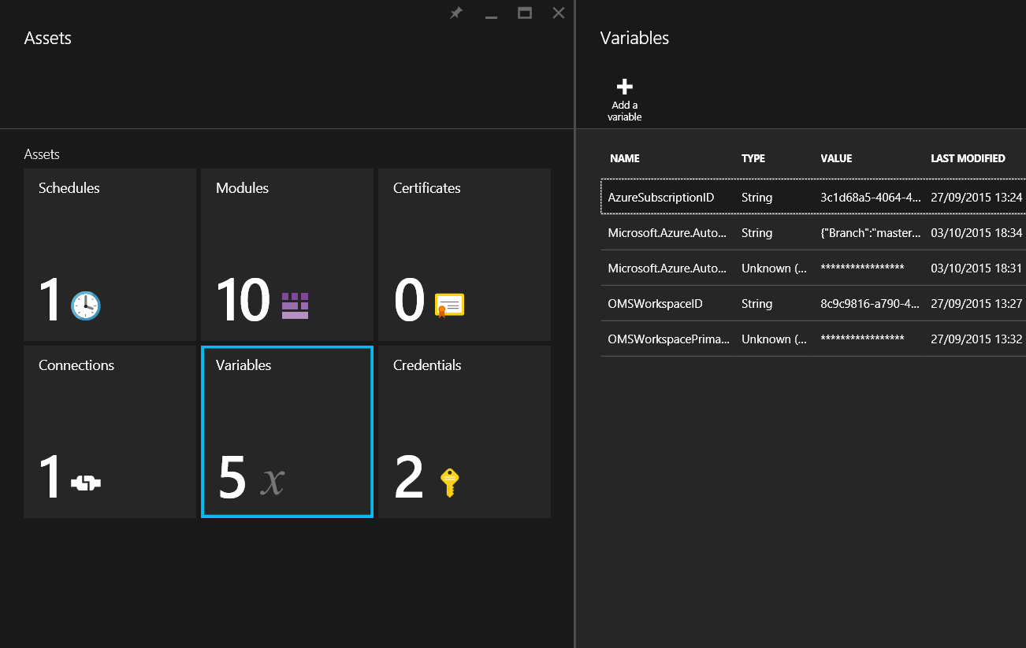
Process Automation - Assets
Schedules
Modules
Certificates
Connections
Variables
Credentials
Notes:
Every Automation Account has assets store. There are different types of assets that you can create. The purpose of assets is to store information or resources that can be used by all runbooks in an Automation Account. Those assets that store information have PowerShell cmdlets for management such as retrieval of asset, creation of asset and so on. Assets are located in the Assets blade and are categorized by their type
Schedules
Schedules enable a runbook to be executed automatically once at a single date and time or multiple times through reoccurring interval. Once schedule is created it can be attached to one or more runbooks.
Modules
Modules in Azure Automation are almost the same as PowerShell Modules. A PowerShell module is a group of PowerShell cmdlets that are executed in PowerShell console, scripts, workflows or runbooks. An example for such cmdlet is Get-Service, which will return services running on a computer. That particular cmdlet is located in the Microsoft.PowerShell.Management module. Azure Automation modules can be imported trough PowerShell Gallery at www.powershellgallery.com or manually. Later in the chapter, we will show you how to package the Azure Resource Manager Module and import it in Azure Automation. Once a module is imported the cmdlets from that module can be used in runbooks.
Certificates
In Azure Automation, certificates can be stored as Assets. Certificates are used by many services as authentication mechanism. For example, Azure Service Management cmdlets allows you to authenticate with certificate instead of credentials.
Connections
Connections are a mix of variables and credentials. A good example would be a connection to an SMTP server, which will have fields such as username, password, SMTPServer and SMTPPort. The advantage of connections compared to credentials and variables is that all this information needed for connecting to service or application is stored in a single object. When a connection is created, a type has to be chosen. Connection type is much like a template that defines the properties of connection and what values are allowed for them. Connections types are added trough importing Azure Automation modules. Not all modules have connection types when being imported in Azure Automaton.
Variables
Variables are containers for storing information. For example, you may have variable named “AzureSubscriptionID” where you store the ID of your Azure Subscription. You can extract the value of that variable in a runbook when you want to work with Azure resources. Variables can be of different types such as String, Boolean, DateTime, Integer and Not Specified. Variables also have the property to be encrypted or not. When a variable is not encrypted, the value can be seen by anyone who have access to the Automation account. When a variable is encrypted, it is stored securely in Azure Automation and can be retrieved only inside a runbook. For example, as the primary key for an Azure Storage account is sensitive data, it should be stored as encrypted variable if you want to use it inside Azure Automation account.
Credentials
Credentials are a set of username and password values. The password is stored securely by being encrypted. When the credential is retrieved inside a runbook, it is retrieved as a PSCredential object. Credentials are used for authentications against servers, applications or services.
Additional information:
https://azure.microsoft.com/en-us/documentation/articles/automation-certificates/
https://azure.microsoft.com/en-us/documentation/articles/automation-connections/
https://azure.microsoft.com/en-us/documentation/articles/automation-credentials/
https://azure.microsoft.com/en-us/documentation/articles/automation-schedules/
https://azure.microsoft.com/en-us/documentation/articles/automation-variables/

Slide 19
Tenant Demo: Executes runbooks to perform tasks on resources
Tenant
Notes:
In this lab the instructor will execute several runbooks that will follow scenario on managing Azure Backup.

Slide 20
Runbook Type Comparison
Capability | Graphical | PowerShell Workflow | PowerShell
Process Visualization | √ | X | X
Checkpoints and Resuming on error | √ | √ | X
Parallel Processing | √ | √ | X
Source Control Integration | X | √ | √
Hybrid Worker Support | √ | √ | √
Webhooks | √ | √ | √
Child runbook execution (Nesting) | Graphical PowerShell Workflow | Graphical PowerShell Workflow | PowerShell
Child runbook exectuon (via Start-AzureAutomationRunbook) | Any | Any | Any
Runbook Authoring | Azure Preview Portal | Azure Preview Portal or offline text editor | Azure Preview Portal or offline text editor
Startup time | Longer, Depends on runbook's complexity | Longer, Depends on runbook's complexity | Short
Complex Logic Implementation | Minimal | Full | Full
Notes:
This table summarizes the main differences between the runbook types.

Slide 21
Insider Tips: Runbook Authoring
Create PowerShell Workflow Runbooks when you have long-running and error-prone tasks
Use Checkpoints when you create PowerShell Workflow Runbooks
Create PowerShell runbooks when you have short tasks that needs to be executed fast
Create Graphical runbooks when you have scarce knowledge in PowerShell
Notes:
Discuss with real-world scenario which type of runbook is suitable for what scenarios.

Slide 22
Desired State Configuration

Slide 23
DSC – DSC Configurations
Configuration SetTimeZone
{
Import-DSCResource -ModuleName xTimeZone
Node TimeZone
{
xTimeZone TimeZoneExample
{
IsSingleInstance = 'Yes'
TimeZone = 'E. Europe Standard Time'
}
}
}
Notes:
DSC Configurations is a new concept in PowerShell 4.0. In declarative PowerShell syntax you define your environment’s state. Configurations are used in PowerShell by defining a script block using the keyword configuration, followed by the name of the configuration which is used as identifier and at last braces to delimit the block.
Configuration SetTimeZone {
...
}
Inside the configuration block a node block needs to be defined. That node block represents a set of servers that should have the same configuration. You can think of node block as a role. A node block starts with the keyword node. After the keyword a name has to be given to that node which can be replaced by variable or expression if needed. At last are the braces to delimit the node configuration block.
Configuration SetTimeZone {
Node "TimeZone" {
...
}
}
Inside the node block, resource block is defined to configure DSC resources. Resource block starts with a name which should be the same as the DSC resource that we want to use. After the name identifier is specified and at last braces are used to delimit the block.
Configuration OMSBook {
Node "TimeZone" {
xTimeZone TimeZoneExample
{
IsSingleInstance = 'Yes'
TimeZone = 'E. Europe Standard Time'
}
}
}
Additional information:
https://azure.microsoft.com/en-us/documentation/articles/automation-dsc-overview/

Slide 24
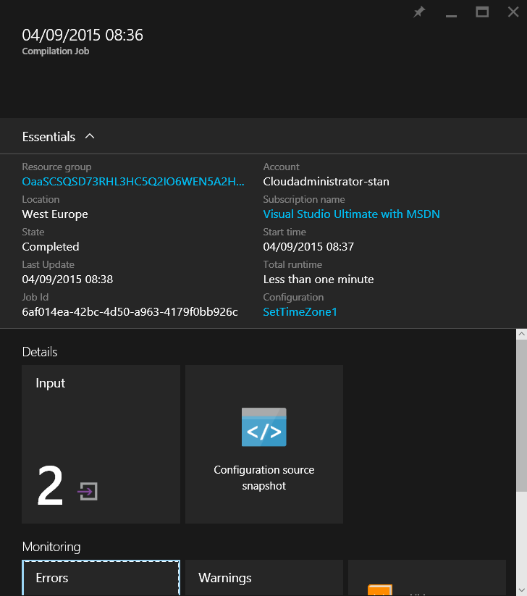
DSC – Compilation Jobs
PowerShell -> MOF
Notes:
When a DSC Configuration is created it needs to be converted to Node Configuration so it can be distributed to Nodes. The instance of such conversion of single DSC Configuration to Node Configuration is called compilation job.
Additional information:
https://azure.microsoft.com/en-us/documentation/articles/automation-dsc-overview/

Slide 25
DSC – Node Configurations
/*
@TargetNode='localhost'
@GeneratedBy=Administrator
@GenerationDate=09/04/2015 05:37:53
@GenerationHost=CLIENT
*/
instance of xTimeZone as $xTimeZone1ref
{
ResourceID = "[xTimeZone]TimeZoneExample";
SourceInfo = "::17::9::xTimeZone";
TimeZone = "E. Europe Standard Time";
ModuleName = "xTimeZone";
ModuleVersion = "1.0.0";
};
Notes:
Node Configuration is the document that is distributed to Nodes so they can run it locally and check their state. Those documents are written in Managed Object Format (MOF). When DSC Configuration is converted to Node Configuration the latter receives name in the following format “<DSC Configuration Name>.<Node Block Name>”.
Additional information:
https://azure.microsoft.com/en-us/documentation/articles/automation-dsc-overview/

Slide 26
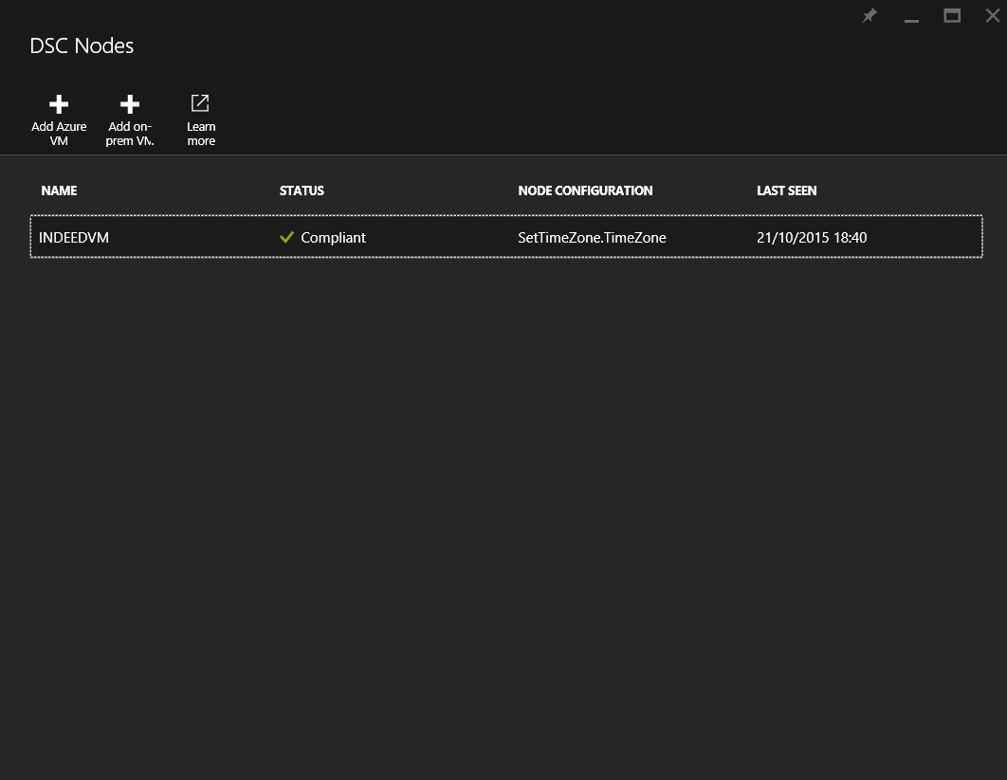
DSC – Nodes
Windows
WMF 5.0
Linux
PowerShell DSC for Linux 1.1
Notes:
A node is any machine that has its configuration managed by Azure Automation DSC Pull Server. Nodes pull Node Configurations from DSC Pull Server and maintain compliance according to what is defined in those configurations. Nodes run those configurations on defined interval and report their state to the DSC Pull server. Because Nodes initiate all the actions to the DSC Pull Server only outbound Internet connection is needed on them.
For Windows machines WMF 5.0 and above is requirement
For Linux machines PowerShell DSC for Liniux 1.1 and above is requirement.
Additional information:
https://azure.microsoft.com/en-us/documentation/articles/automation-dsc-overview/

Slide 27
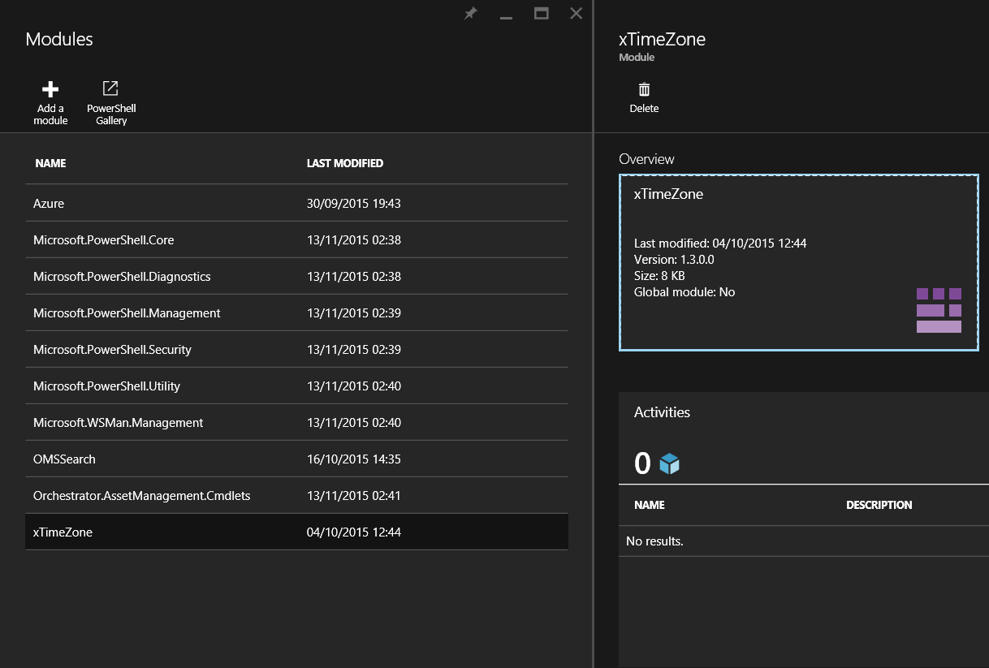
DSC – Assets
DSC Resources
Variables
Connections
Credentials
Certificates
Notes:
DSC Resources are the building blocks for creating and running configurations. DSC for Windows and Linux comes with a set of built-in resources that can be used out of the box. Additional DSC resources can be imported the same as PowerShell Modules are imported in Azure Automation. When additional DSC resource is used in a configuration, that resource will be pulled by the node from the Azure Automation DSC Pull Server prior to running the configuration.
Other assets from Azure Automation asset store can be used as global information for DSC Configurations
Additional information:
https://azure.microsoft.com/en-us/documentation/articles/automation-dsc-overview/

Slide 28
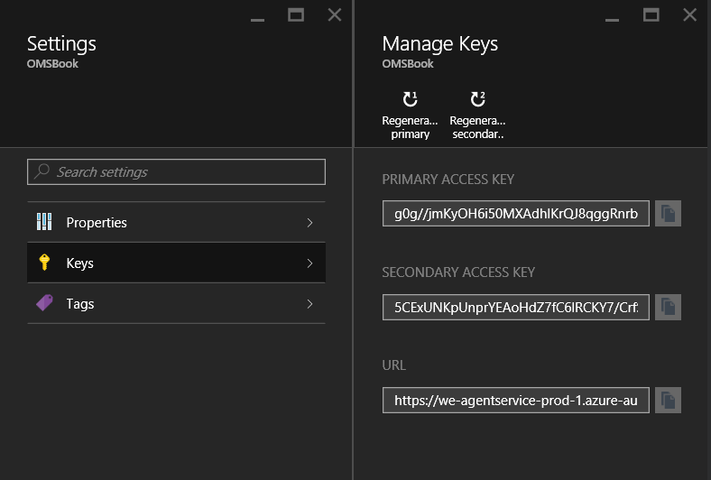
DSC – DSC Pull Server
Highly-Available
No Maintenance
UI
Reports
Notes:
DSC Pull Server is the place where all the above resources are being managed. When Azure Automation Account is created a logical DSC Pull Server is created for that account to enable the DSC functionality.
Additional information:
https://azure.microsoft.com/en-us/documentation/articles/automation-dsc-overview/

Slide 29
DSC – Lifecycle
Notes:
The diagram represents the main steps from having DSC configuration to applying it to DSC nodes.
Additional information:
https://azure.microsoft.com/en-us/documentation/articles/automation-dsc-overview/

Slide 30
Insider Tips: Automation DSC
Use Credentials from assets in DSC Configurations to pass sensitive data securely
Start with small DSC configurations and build upon them
Notes:
Credentials from asset store are stored securely and by using them in DSC Configurations they are passed securely. Use PSDscAllowPlainTextPassword = $True in configuration data when using credentials from asset store.
Managing infrastructure as code is a mind shift and it is always better to start small

Slide 31
Service Admin Demo: Writes, compiles and applies configuration to nodes Tenant Demo: Adds Nodes to Automation DSC
Service Admin
Tenant
Notes:
In this lab Tenant adds node to Automation DSC
Service Admin applies configurations to that node to make it compliant.

Slide 32
Automation Structure
Notes:
This diagram provides information on the main components discussed in previous slides and how they are tied together.

Slide 33
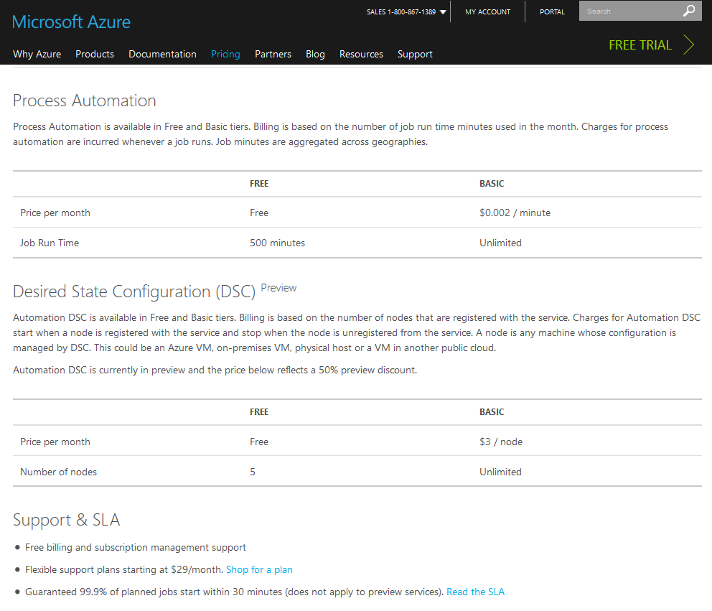
Pricing
Process Automation
Job run time - Based on how much time your runbook jobs execute in the system
Desired State Configuration*
Number of nodes – Based on the number of nodes managed by Automation DSC
*Prices listed are for DSC Preview
Notes:
https://azure.microsoft.com/en-us/pricing/details/automation/

Slide 34
DevOps
Implement and enhance DevOps with Azure Automation
Integration with third party services
Source control your runbooks
Manage Infrastructure as a code
Notes:
This section starts walking trough more advanced Automation feature that can be used in DevOps scnearios.

Slide 35
Hybrid Worker
Notes:
By default, Azure Automation runbooks are executed on Worker nodes located in Azure that are shared between different automation accounts but jobs are completely isolated from each other in a secure manner. Because jobs on Azure worker nodes it is hard to access resources that are located on-premise. Fortunately, Azure Automation has a solution for that called Hybrid Worker. Simply put you can connect on-premises server to your Azure Automation Account and when you run runbooks you can say that you want to be executed on that server instead in Azure. The runbooks are stored and managed in Azure Automation but delivered to one or more on-premises servers and executed there. The server designated for Hybrid Worker does not need inbound connection to Internet, only outbound. The Hybrid worker initiates all communication to Azure Automation in the cloud. When a runbook is started from Azure Preview Portal to a Hybrid Worker, the Hybrid Worker creates a retrieve instruction for the runbook. The Hybrid Worker pulls down the runbook and any assets before running it. Assets that that are retrieved in the runbook are also pulled by the Hybrid Worker from Azure Automation. When Hybrid Worker is being setup it is added in a Hybrid Runbook Worker Group. In a Hybrid Runbook Worker Group, you can put one or multiple servers. When you start a runbook you designate on which Hybrid Runbook Worker Group should be running. By having a Hybrid Runbook Worker Group with more than one node you achieve high-availability, because runbooks will start only on servers that are running and healthy.
Additional information:
https://azure.microsoft.com/en-us/documentation/articles/automation-hybrid-runbook-worker/

Slide 36
Insider Tips: Hybrid Workers
Use Hybrid Workers to manage on-premises resources
Use more than one Hybrid Workers in a Group to provide high availability
Use inlinescript{…} to connect to other computers in your environment from Hybrid Workers
Notes:
Hybrid workers are very useful for on-premises resources. Basically trough that feature Azure Automation provides single management of resources located on-premises and in the cloud.

Slide 37
Webhooks
3rd party services integration
No need to special coding
Pass parameters
Authentication with URL
Notes:
A webhook gives you the ability to start a runbook with a simple web request. This allows other services or applications to start runbooks without implementing the Azure Automation API. For example, such services are Visual Studio Online, GitHub, Azure alerts and OMS. When a webhook is created a few properties needs to be specified:
• Name – Name is irrelevant to the service that will call the runbook. This property is used to identify the runbook in Azure Automation. As a best practice, you should give the webhook a name related to the service that will use it.
• Enabled – This property designates whether the webhook should be enabled or disabled. Default value is enabled.
• Expires – Every webhook has expiration date. Once webhook is created its expiration date cannot be modified. A webhook that has reached expiration date cannot be re-enabled. In order to replace expired runbook you must generate a new one.
• URL – This is the URL of the webhook. It is unique address to which a web request is executed from another service. This URL is automatically generated by the service and you cannot change it on your own. The URL also contains token that authorizes other services to execute the runbook. It can be viewed only upon creation and once it is created cannot be retrieved. Webhook URLs should be stored in secure location.
If a runbook has mandatory input parameters, we must give values to those parameters upon webhook creation. If there are input parameters that are not mandatory, we can assign values but we are not obligated to do it. Multiple webhooks linked to a single runbook can each use different parameter values. When a service starts a runbook using a webhook, it cannot override the parameter values defined in the webhook. To be able to send data into the runbook you must create input parameter called $WebhookData of type [object]. This object will contain the data that is included in the web request to the webhook. The $WebhookData object has three properties:
• WebhookName – Contains the name of the webhook.
• RequestHeader – Contains the headers of the web request in a hash table format.
• RequstBody – Contains the body of the web request. This property can contain various types of data like string, JSON, XML or form encoded data. You must write your runbook in a way that is able to convert and format the data that is passed.
When value for $WebhookData input object is specified during webhook creation that value will be overridden when the webhook is called from another service.
As the URL of the webhook is sensitive data and can be compromised it is best practice to include additional logic in your runbook on the data passed to $WebhookData. Such logic could be to check if specific data is passed to the runbook and that data can only come from the service for which the webhook was intended to.
Additional information:
https://azure.microsoft.com/en-us/documentation/articles/automation-webhooks/

Slide 38
Insider Tips: Webhooks
Store webhook URLs and date expiration in a secure store
Implement additional logic in your runbooks in case the webhook URL is compromised
Notes:
Webhook URLs are like passwords so they should be stored in secure stores.
Always implement additional logic in your runbooks like including Authorization value (something like Key word) that allows the runbook to be executed fully. If that value is not passed runbook should fail.

Slide 39
Tenant Demo: Execute runbooks from webhooks with PowerShell web request cmdlet
Tenant
Notes:
In this lab instructor will execute the same runbook from previous labs but using webhook instead of the Azure Portal.

Slide 40
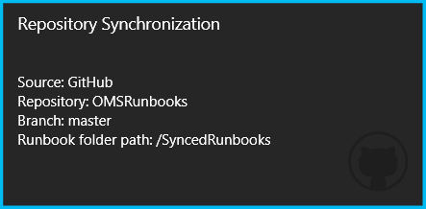
Source Control Integration
Collaboration
Backup and restore of runbooks
Maintain Change History
DevOps
Notes:
When you author runbooks you usually go through a number of changes before reaching to a runbook version that gives you the desired results. But even when you reach that version you often introduce small improvements or introduce new features to your runbook. The point is that a runbook has a lifecycle with a number of changes made through it. When a change to a runbook is made it needs to be documented. Documentation provides the reason why the change was introduced and also gives the state of the runbook before the change and after the change. It also gives information when the change was made and by whom. To ease this process source control system are used. The term for change in source control system that is mostly used is revision. Source control systems track those revisions automatically. Revisions can be compared, restored, and with some types of files, merged. Runbooks should always be treated as a code and because of that you should always use source control system when you author them.
Currently Azure Automation out of the box allows integration with source control system called GitHub. Integration with another system called Visual Studio Online is planned as well but for later period.
Additional information:
https://azure.microsoft.com/en-us/documentation/articles/automation-source-control-integration/

Slide 41
Insider Tips: Source Control Integration
Use GitHub as Source Control to keep track of the runbook changes
Use private GitHub repository for runbooks that should not be exposed publically
When runbooks are synced from GitHub repository publish them so that new jobs are using the latest versions

Slide 42
Service Admin Demo: Setup Source Control Integration
Service Admin
Notes:
In this lab the instructor sets up Source Control integration with GitHub and provides overview on how to use it.

Slide 43
Lab: Automation Account Deployment Source Control Setup and Runbook synchronization Execute runbooks to manage Azure Backup Apply configurations to computers via Automation DSC
Service Admin
Tenant

